Slide 1
Introduction to R
A very brief intro before put your hands on R

Slide 2


Slide 3
S
1984, … S+- 1987

Slide 4
R for Statistics
Domain Specific Languages

Slide 5

R, S and T !!!
1990 -- 1997
Robert Gentleman and Ross Ihaka

Slide 6
R is
GNU General Public License
Open Source
Data handling and storage: numeric, textual
Matrix algebra
Hash tables and regular expressions
High-level data analytic and statistical functions
Classes (“OO”)
Graphics
Programming language: loops, branching, subroutines

Slide 7

R for What?
Bayesian Inference
Clinical Trials
Cluster Analysis
Computational Physics
Differential Equations
Econometrics
Environmental Studies
Experimental Design
Finance
Genetics
Graphical Models
Graphics and Visualizations
High Performance Computing
High Throughput Genomics
Machine Learning
Medical Imaging
Meta Analysis
Multivariate Statistics
Natural Language Processing
Official Statistics
Optimization
Etc.

Slide 8
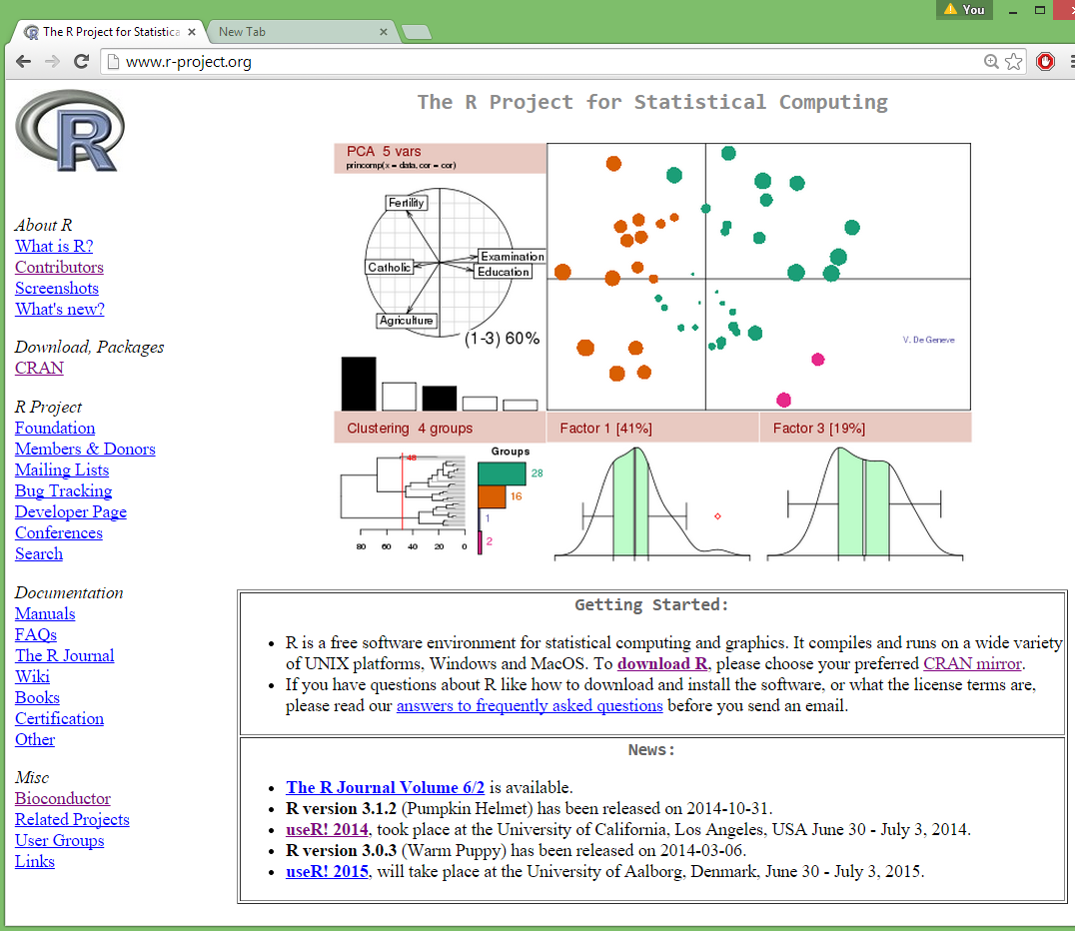
http://r-project.org

Slide 9
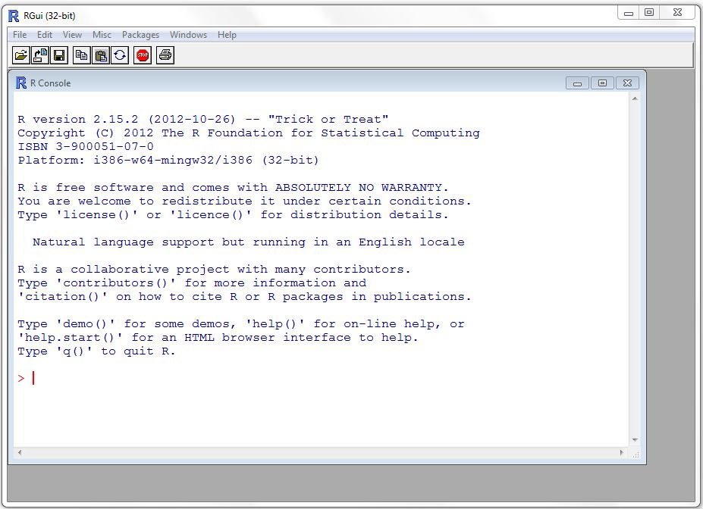

R

Slide 10

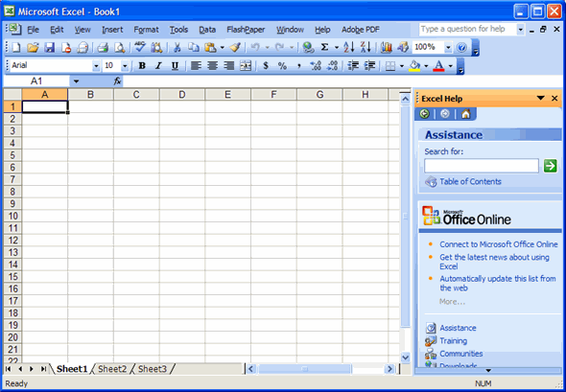
R has a language

Slide 11
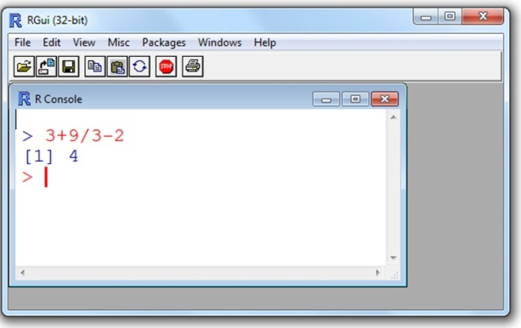
R as a calculator
> 10+20/2
[1] 20
> sqrt(16)
[1] 4
> log(1000)
[1] 6.907755
> log10(1000)
[1] 3
> log2(4)
[1] 2

Slide 12
Variables
> x = 25
> x
[1] 25
> y = "y is a string"
> y
[1] "y is a string"
> 1+1==3
[1] FALSE

Slide 13
Objects in R
> x <- c(1,2,3,4,5,6)
> x
[1] 1 2 3 4 5 6
> x = matrix(c(10,20,30,40,50,60,70,80,90,100), nrow=5, ncol=2)
> x
[,1] [,2]
[1,] 10 60
[2,] 20 70
[3,] 30 80
[4,] 40 90
[5,] 50 100

Slide 14
Dataframes
> SlNo<-c(1,2,3,4)
> Name<-c("Raju", "Radha", "Mayavi", "Luttapi")
> Age<-c(18,17,20,18)
> table<-data.frame(SlNo,Name,Age)
> table
SlNo Name Age
1 1 Raju 18
2 2 Radha 17
3 3 Mayavi 20
4 4 Luttapi 18

Slide 15
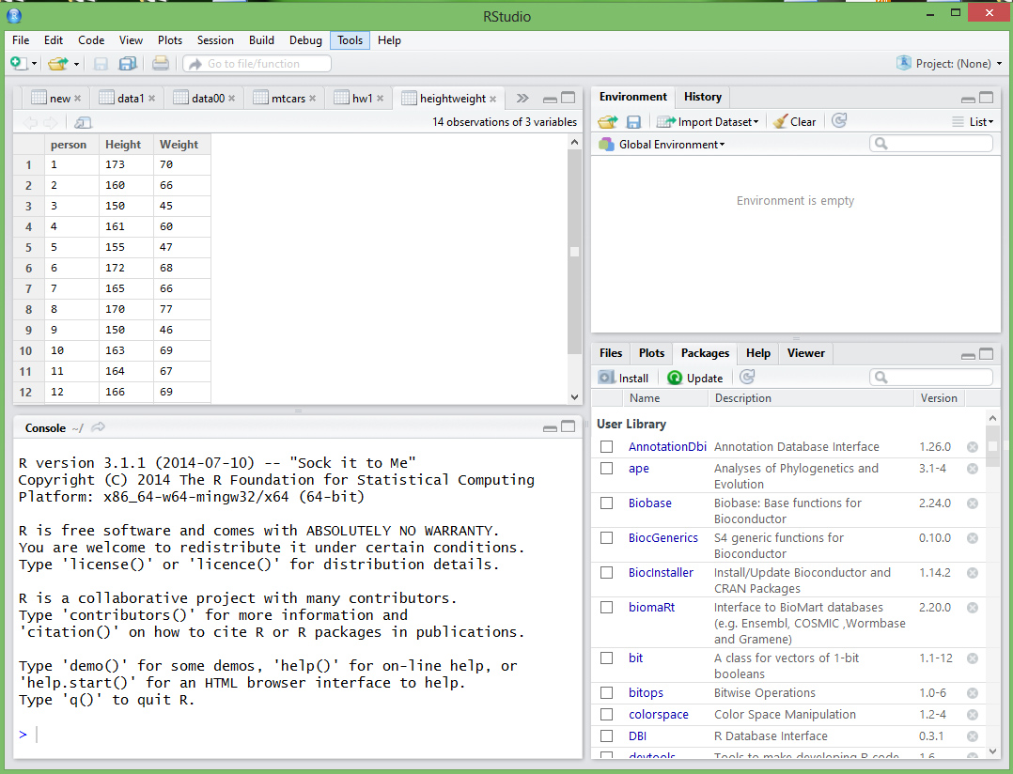
Rstudio

Slide 16
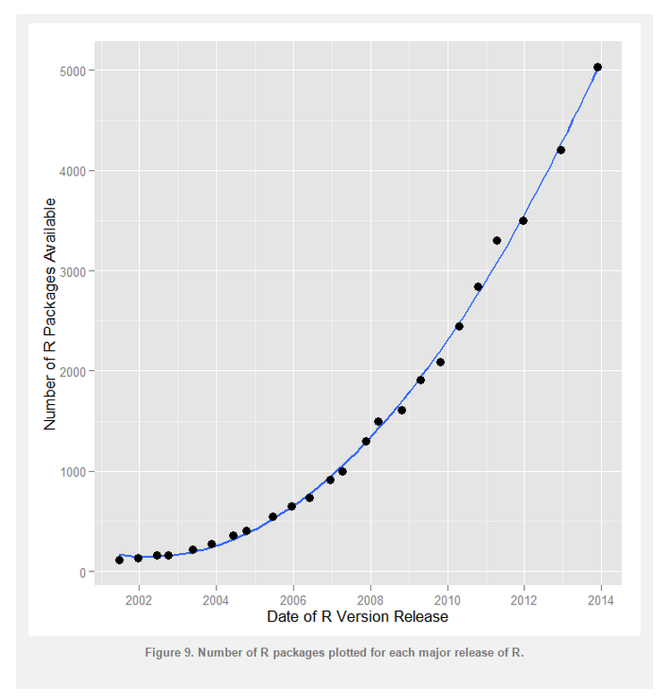
Packages

Slide 17
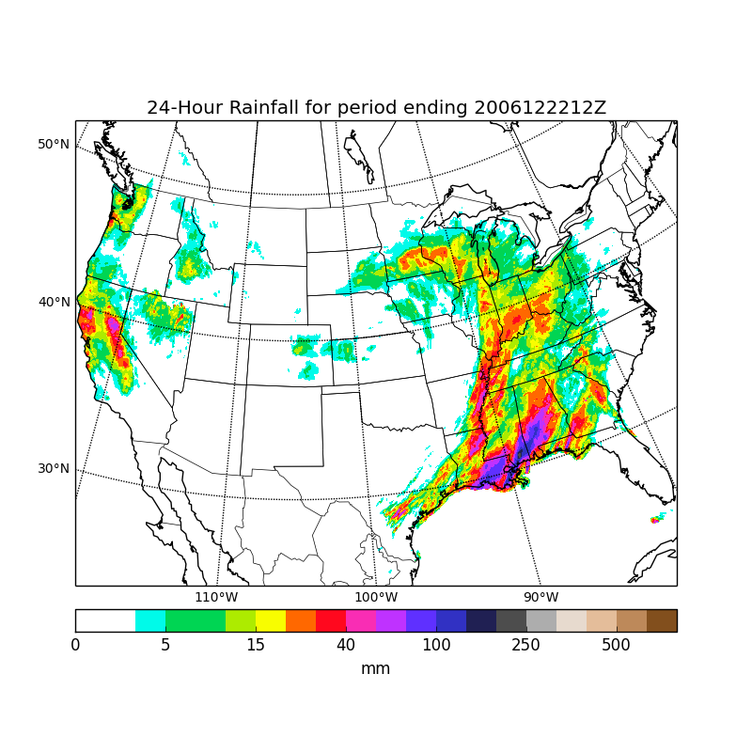
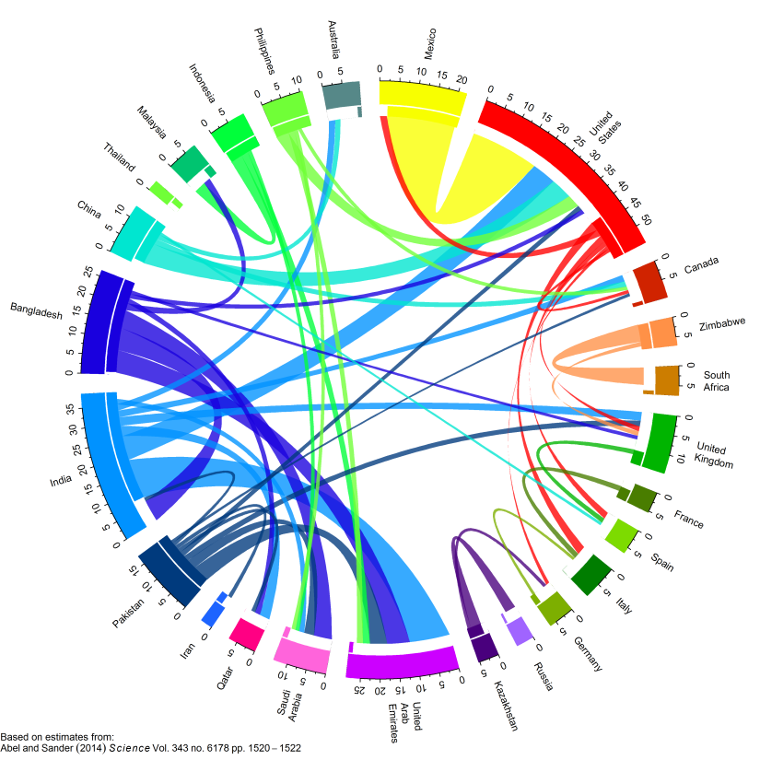
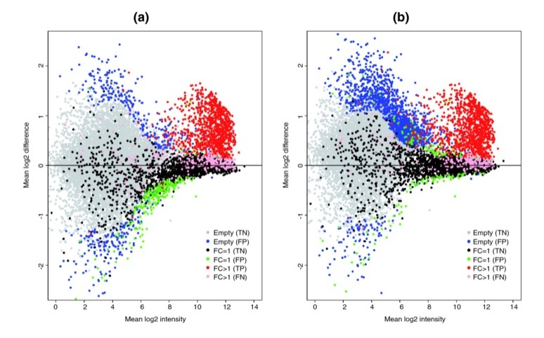
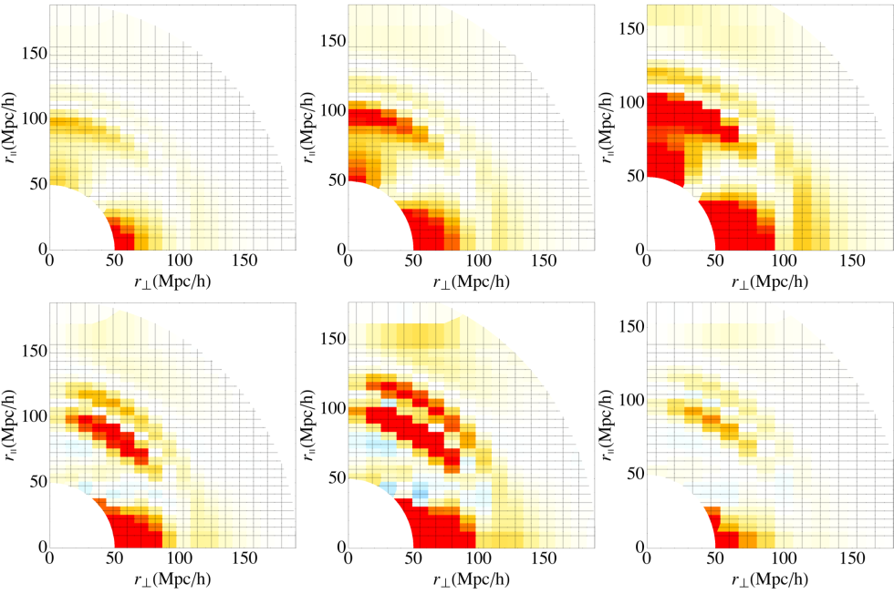
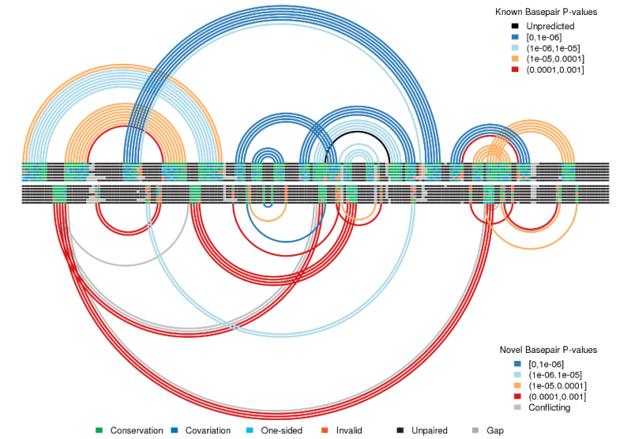
Powerful plots in R

Slide 18
Regular expression
> month.name
[1] "January" "February" "March" "April" "May" "June" [7] "July" "August" "September" "October" "November" "December“
> month.name[grep("A", month.name)]
[1] "April" "August

Slide 19
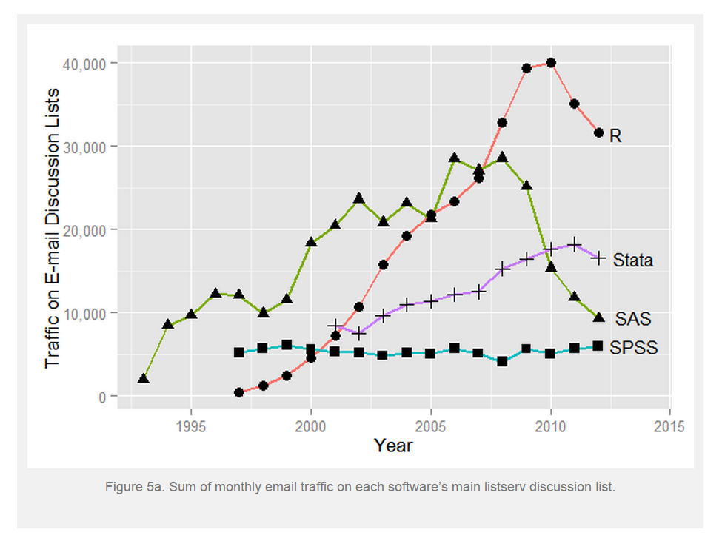

Slide 20
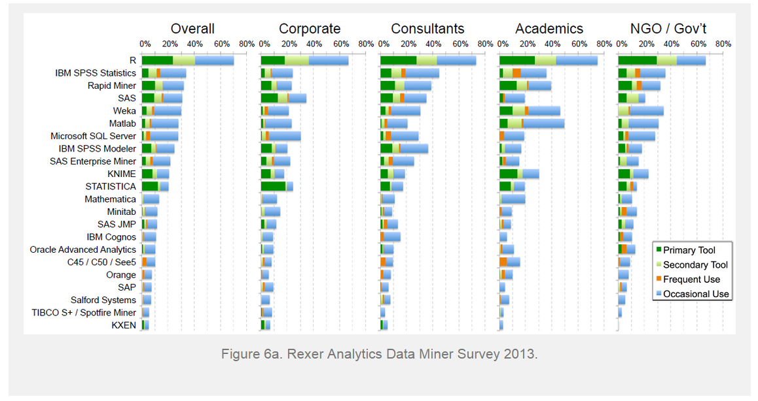

Slide 21
TYPE OF STATISTICAL ANALYSIS | R | MATLAB | SAS | STATA | SPSS
Nonparametric Tests | Yes | Yes | Yes | Yes | Yes
T-test | Yes | Yes | Yes | Yes | Yes
ANOVA & MANOVA | Yes | Yes | Yes | Yes | Yes
ANCOVA & MANCOVA | Yes | Yes | Yes | Yes | Yes
Generalized Least Squares | Yes | Yes | Yes | Yes | Yes
Ridge Regression | Yes | Yes | Yes | Limited | Limited
Lasso | Yes | Yes | Yes | Limited
Nonlinear Regression | Yes | Yes | Yes | Limited | Limited
Discriminant Analysis | Yes | Yes | Yes | Yes | Yes
Nearest Neighbor | Yes | Yes | Yes |  | Yes
Naive Bayes | Yes | Yes |  |  | Limited
Factor & Principal Components Analysis | Yes | Yes | Yes | Yes | Yes
Canonical Correlation Analysis | Yes | Yes | Yes | Yes | Yes
Copula Models | Yes | Yes | Experimental
Path Analysis | Yes | Yes | Yes | Yes | Yes
Structural Equation Modeling (Latent Factors) | Yes | Yes | Yes | Yes | AMOS
Extreme Value Theory | Yes | Yes
Variance Stabilization | Yes | Yes
Bayesian Statistics | Yes | Yes | Limited
Monte Carlo, Classic Methods | Yes | Yes | Yes | Yes | Limited
Markov Chain Monte Carlo | Yes | Yes | Yes
Bootstrap & Jackknife | Yes | Yes | Yes | Yes | Yes
EM Algorithm | Yes | Yes | Yes
Missing Data Imputation | Yes | Yes | Yes | Yes | Yes
Robust Estimation | Yes | Yes | Yes | Yes
Cross-Validation | Yes | Yes | Yes
Longitudinal (Panel) Data | Yes | Yes | Yes | Yes | Limited
Survival Analysis | Yes | Yes | Yes | Yes | Yes
Propensity Score Matching | Yes | Yes | Limited | Limited
Stratified Samples (Survey Data) | Yes | Yes | Yes | Yes | Yes
Experimental Design | Yes | Yes | Limited
Quality Control | Yes | Yes | Yes | Yes | Yes
Univariate Time Series | Yes | Yes | Yes | Yes | Limited
Multivariate Time Series | Yes | Yes | Yes | Yes
Stochastic Volatility Models, Discrete Case | Yes | Yes | Yes | Yes | Limited
Stochastic Volatility Models, Continuous Case | Yes | Yes | Limited | Limited
Diffusions | Yes | Yes
Markov Chains | Yes | Yes
Hidden Markov Models | Yes | Yes
Counting Processes | Yes | Yes | Yes
Filtering | Yes | Yes | Limited | Limited
Instrumental Variables | Yes | Yes | Yes | Yes | Yes
Simultaneous Equations | Yes | Yes | Yes | Yes | AMOS
Splines | Yes | Yes | Yes | Yes
Nonparametric Smoothing Methods | Yes | Yes | Yes | Yes
Cluster Analysis | Yes | Yes | Yes | Yes | Yes
Neural Networks | Yes | Yes | Yes |  | Limited
Classification & Regression Trees | Yes | Yes | Yes |  | Limited
Boosting Classification & Regression Trees | Yes | Yes | Limited
Random Forests | Yes | Yes | Limited
Support Vector Machines | Yes | Yes | Yes
Signal Processing | Yes | Yes
Wavelet Analysis | Yes | Yes | Yes
Bagging | Yes | Yes | Yes
ROC Curves | Yes | Yes | Yes | Yes | Yes
Deterministic Optimization | Yes | Yes | Yes | Limited
Stochastic Optimization | Yes | Yes | Limited

Slide 22











R in industry?

Slide 23
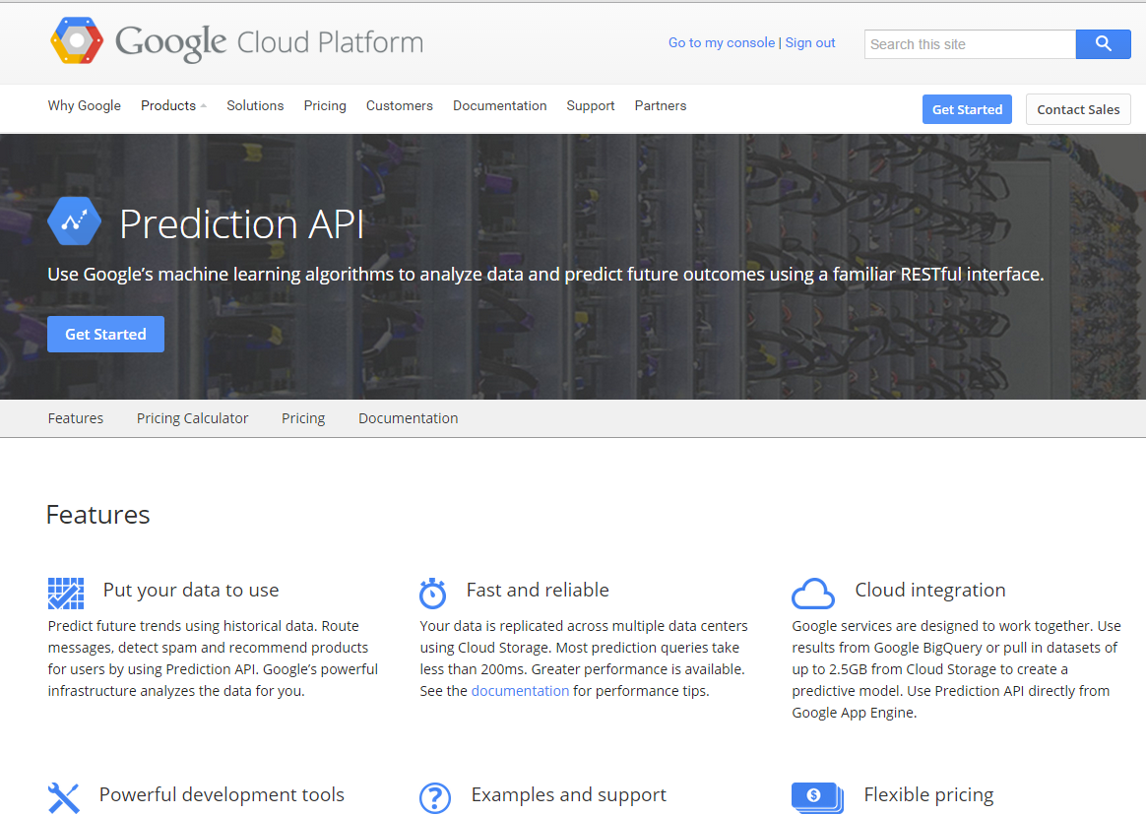

Social and marketing trends

Slide 24
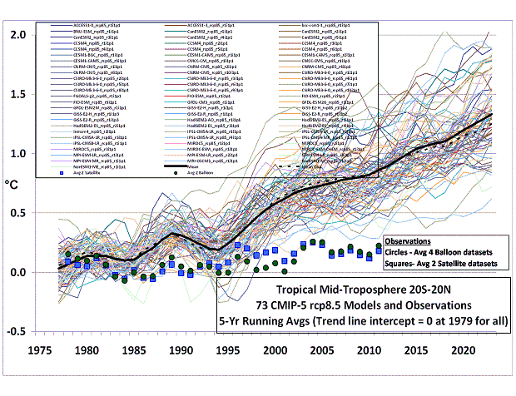
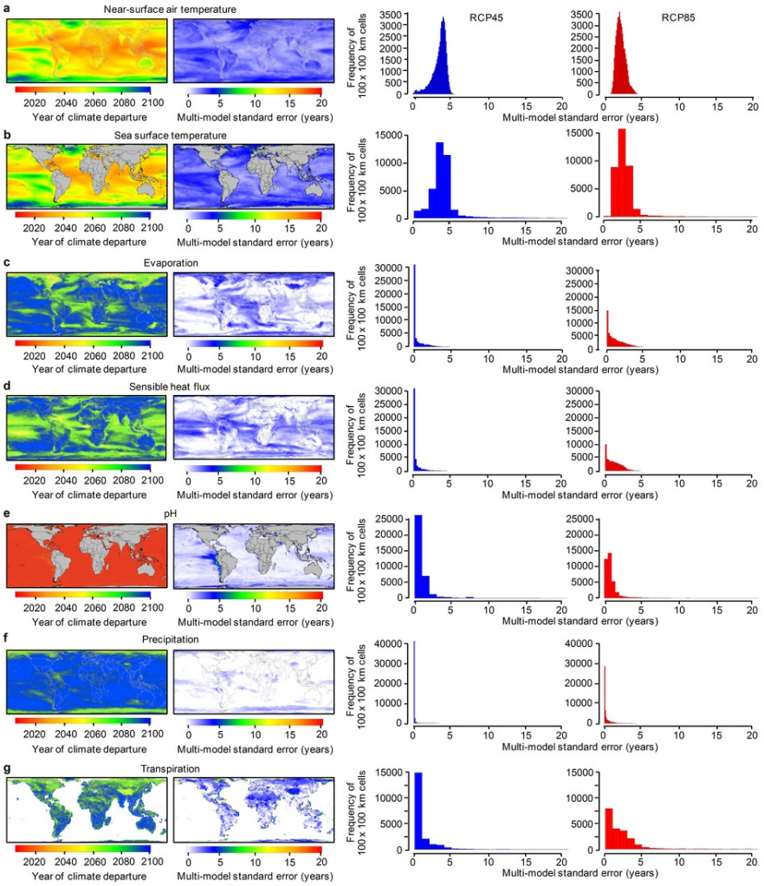
Financial and climate models

Slide 25
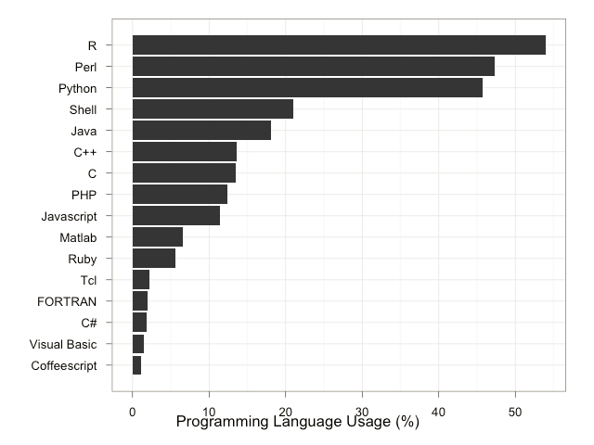
R for Bioinformatics

Slide 26
Resources
Impatient R
tryR
R Graph Gallery
Stack Overflow
Crossvalidated
TalkStats
R-bloggers (400 + separate blogs )
Cookbook for R
Learning R
Revolutions

Slide 27

Resources
Online books
Mailing lists
R script editors, GUIs and IDEs
Videos
Tutorials
MOOC (coursera)
http://tryr.codeschool.com/

Slide 28


Slide 29


R is friendly with other lang.
Interacts with C, C++, Java, .NET, Python etc
RWeka

Slide 30

Speed…..
BUT is DSL
Not C

Slide 31
Lets move to the tutorial session
bit.ly/rhandout

